Slide 1
Docker and Containerization
Atul Kahate

Slide 2
Background: Part 1
Developer develops on his/her own machine and environment (OS, Libraries, Versions)
Testing and Customer (Production/Live) Environment could be quite different!
After Requirements and Design stages are complete
Developer develops on his/her own machine and environment (OS, Libraries, Versions)
Developer develops on his/her own machine and environment (OS, Libraries, Versions)

Slide 3
Background: Part 2
Software development earlier
Coding + Testing + Implementation cycles could take several months/years
Software development now
Requirements + Design + Coding + Testing + Implementation cycles must complete in weeks/days

Slide 4
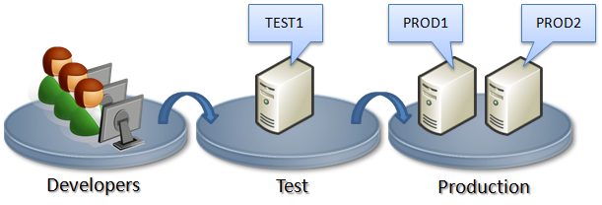
Background – 3
The same code works on Developers machines, but not on Test/Production servers!

Slide 5
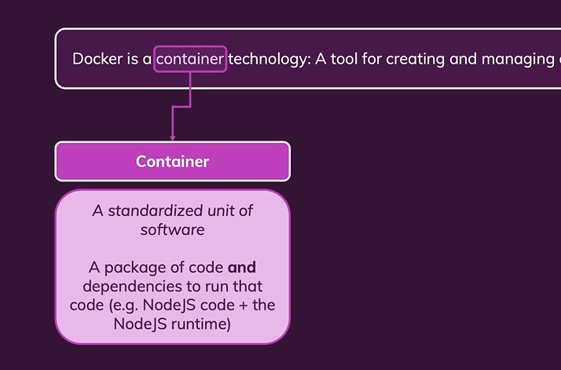
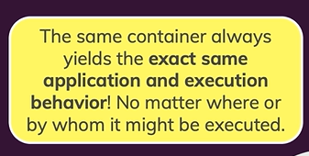
Container and its Main Advantage

Slide 6
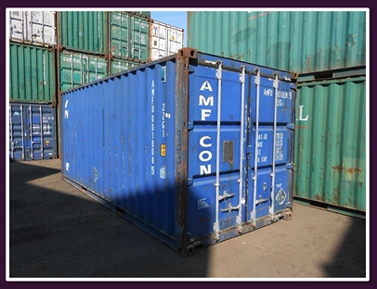
Why the name Container?
Self-contained
Isolated
Can be put on any truck or ship that can carry the container

Slide 7
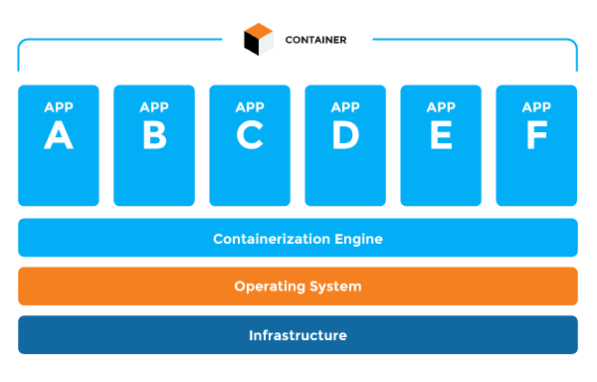
Container Concept

Slide 8
How Does Containerization Work?
Application containers work by virtualizing the operating system.
Each application container thinks that it is the only application running on a machine.
Each container is defined as a single running application and a set of supporting libraries.
Important: Containers differ from virtual machines. Containers are immutable - they can’t be modified by any action that you take. This is on purpose—it means that every time you create a container, it’ll be the same.

Slide 9



Container Creation
The same container can run on any OS now
Container will contain your software code and all the libraries/dependencies needed by your software
Specify what all you require to build and execute your application
Use Docker to create a container

Slide 10
Why Containerization?
A container works exactly the same, no matter where it was created and where it is being executed – from a laptop to a data center, or cloud
That kind of consistency eliminates an entire class of bugs.
A container is like a virtual machine snapshot.
Each time you start a container, it’s restored to the initial snapshot no matter what actions you took the last time it ran.

Slide 11
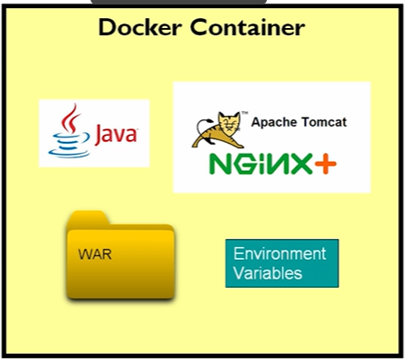
Container Example

Slide 12
Traditional vs Containerized Application Deployment
Programs
Programs
JVM
Tomcat
MySQL
WAR file
Deploy
Docker Image
Programs + JVM + Tomcat + MySQL

Slide 13
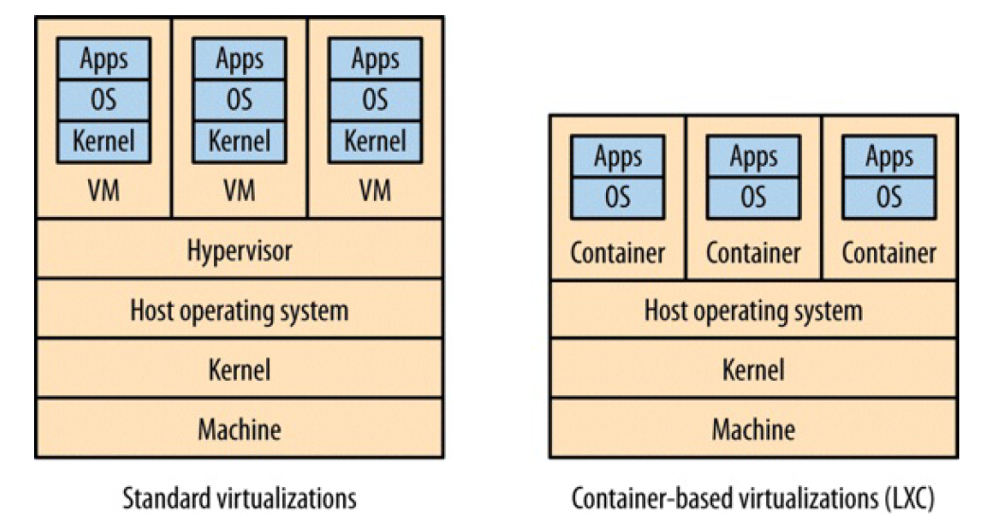
Virtualization versus Containers

Slide 14
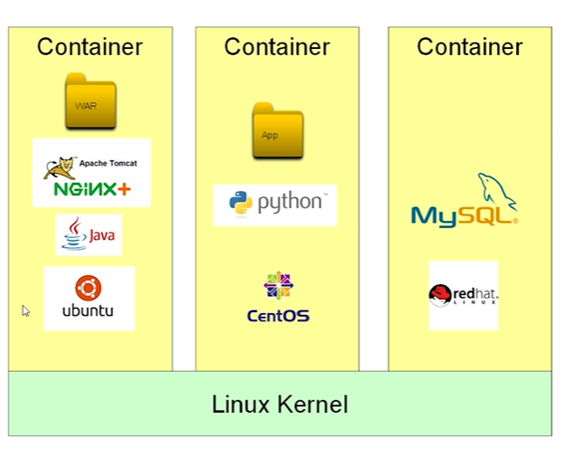
Container vs Virtual Machine
Container does not contain an OS – hence it is lightweight
Then why Ubuntu, CentOS, redhat below?

Slide 15
Container vs Virtual Machine
Common confusion about a container – People think that the container also contains an operating system
WRONG!
When we see OS inside the container, that is not the kernel of the OS
The OS here only has OS utility programs that the creators of the container need, e.g. cat command, an editor
So, in the previous diagram, all the containers will share the same Linux kernel shown at the bottom

Slide 16
Docker

Slide 17
What is Docker?
Docker is a platform that allows you to “build, ship, and run any app, anywhere.”

Slide 18
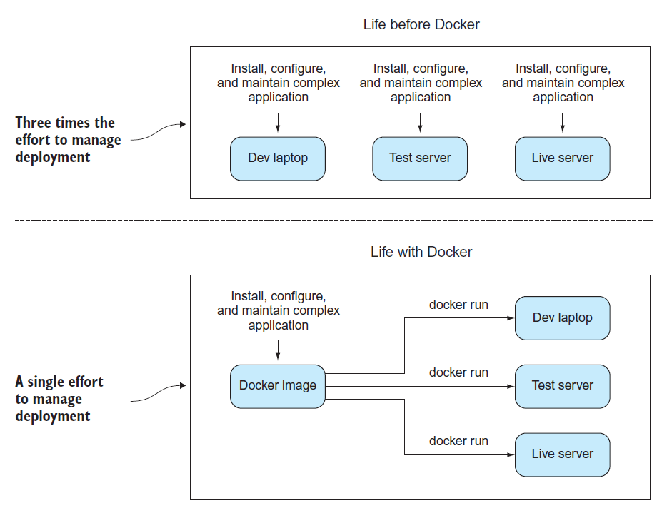
Life Before and After Docker

Slide 19
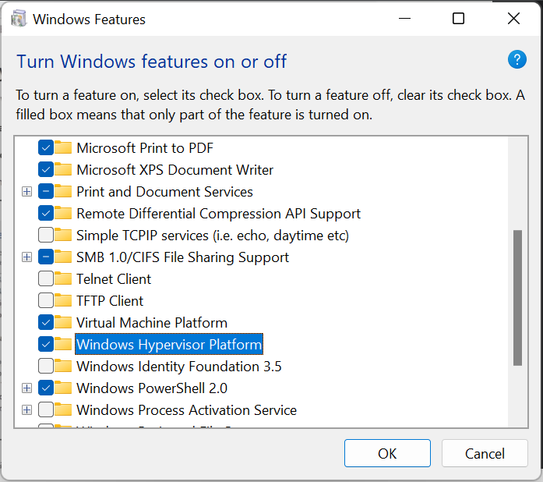
Check for Virtualization Support
Search for ‘Turn Windows Features on or off’
Then check the checkboxes, if required and restart

Slide 20
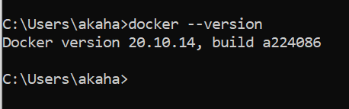
Docker Installation – 1
Install: https://docs.docker.com/desktop/windows/install/
(Docker Desktop is actually a hidden VM containing Linux)
If you get this error: ‘Docker WSL 2 installation is incomplete’
Download the package (Step 4 in the link): https://docs.microsoft.com/en-us/windows/wsl/install-manual#step-4---download-the-linux-kernel-update-package
Restart docker

Slide 21
Problems?
First enable WSL so you can run a command in Administrator PowerShell:
dism.exe /online /enable-feature /featurename:Microsoft-Windows-Subsystem-Linux /all /norestart
Update to the WSL2 by this command in PowerShell:
dism.exe /online /enable-feature /featurename:VirtualMachinePlatform /all /norestart
Also see this: https://www.c-sharpcorner.com/article/how-to-install-docker-desktop-and-troubleshoot-issues-in-windows-machine/

Slide 22
‘Hello World’ in Docker

Slide 23
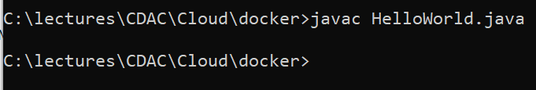
‘Hello World’ in Java using Docker
Create HelloWorld.java in C:\lectures\CDAC\Cloud\docker\hello-world-java\HelloWorld.java
public class HelloWorld {
public static void main(String[] args) {
System.out.println("Hello, World");
}
}
Compile: javac HelloWorld.java

Slide 24
Create Dockerfile
C:\lectures\CDAC\Cloud\docker\hello-world-java\Dockerfile
FROM openjdk:11-jre-slim
ADD HelloWorld.class /
CMD ["java", "HelloWorld"]
Get the JRE
Add HelloWorld.class into the Docker image
Execute the HelloWorld class at the command prompt
CMD command in Docker specifies the instruction to be executed when a Docker container starts – it is NOT the Windows cmd command!
The main purpose of the CMD command is to launch the software required in a container.

Slide 25
Important points to avoid confusion!
We will see other examples where we have RUN and CMD commands in a Dockerfile – they are different
RUN command is used as a step in building a Docker image. Example below:
RUN javac Main.java
This step will help us in compiling a Java program, which we next want to execute
Now we can use the CMD command:
CMD ["java", "Main"]
To execute the Dockerfile: docker run …
So, RUN is an intermediate command, and a Dockerfile can have multiple RUN commands
Also, RUN inside Dockerfile and docker run are different commands with different purposes
CMD is the command that finally runs the file that we want to execute when we use a docker run command

Slide 26
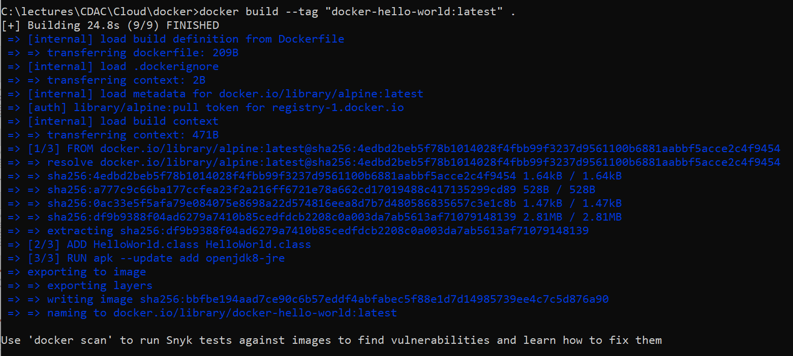
Build the Docker Image
docker build --tag "docker-hello-world:latest" .

Slide 27
Execute the Container
docker run docker-hello-world:latest

Slide 28
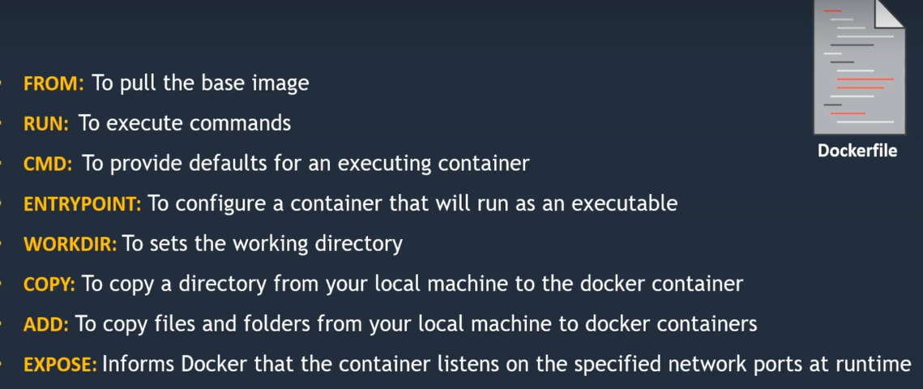
Dockerfile Commands

Slide 29
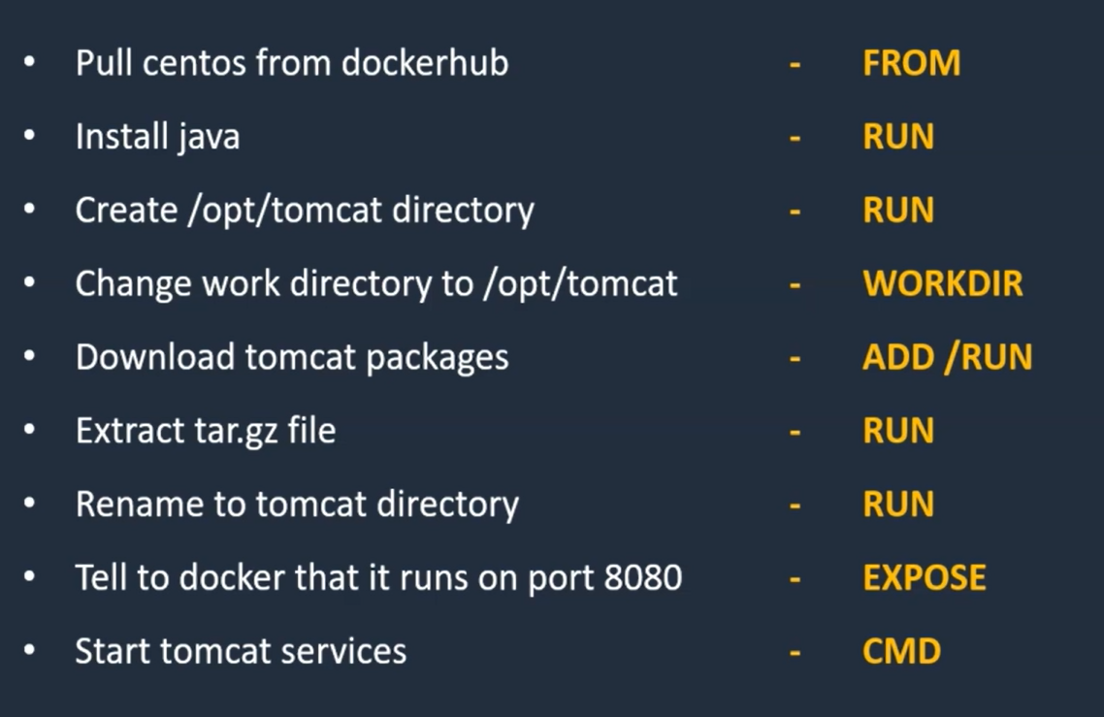
Example: Install Tomcat on CentOS

Slide 30
Example Dockerfile for this C:\lectures\CDAC\Cloud\docker\tomcat-on-centos\Dockerfile)
FROM centos:7
RUN yum install -y \
java-1.8.0-openjdk \
java-1.8.0-openjdk-devel
RUN mkdir /opt/tomcat
WORKDIR /opt/tomcat
ADD https://dlcdn.apache.org/tomcat/tomcat-9/v9.0.70/bin/apache-tomcat-9.0.70.tar.gz .
RUN tar -xvzf apache-tomcat-9.0.70.tar.gz
RUN mv apache-tomcat-9.0.70/* /opt/tomcat
EXPOSE 8080
CMD ["/opt/tomcat/bin/catalina.sh", "run"]

Slide 31
Build and Run the Image/Container
docker build –t tomcat-centos .
docker run -p 8080:8080 tomcat-centos
Open browser and test: localhost:8080

Slide 32
‘Hello World’ in Python

Slide 33
Create hello_world.py (C:\lectures\CDAC\Cloud\docker\hello-world-python)
from time import sleep
# the program will print hello world
# every 1 second forever
while True:
print("Hello, World")
sleep(1)

Slide 34
Dockerfile
FROM python:3
ADD hello_world.py .
CMD ["python", "-u", "hello_world.py"]

Slide 35
Why From python: 3?
FROM python:3
This is your base image, the starting point.
In this case, it is the official image from the Python Software Foundation and has Python:3 installed.
That means we don’t have to install any framework; it’s already included with this base image.

Slide 36
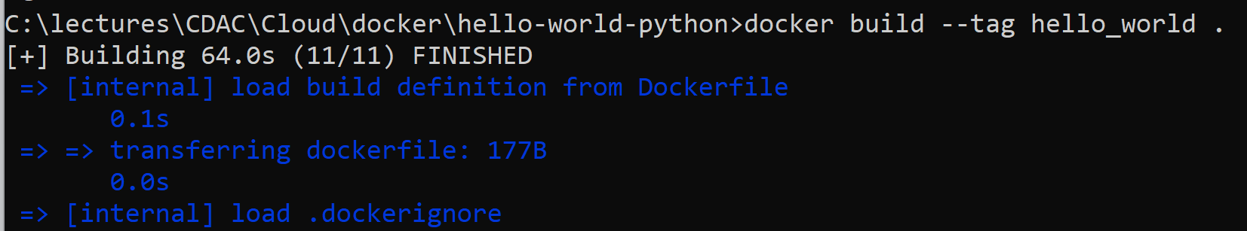
Running the Docker image
docker build -t hello_world .
Verify image creation: docker images

Slide 37
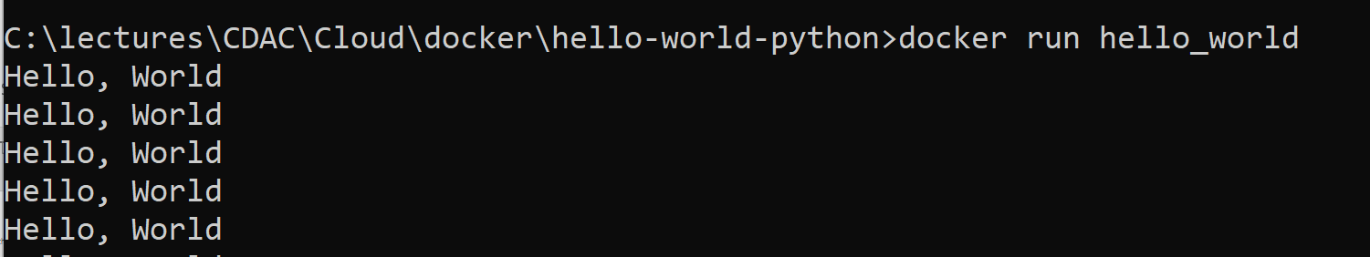
Running the Container
docker run hello_world
Will get into an endless loop – How to break? See next slide

Slide 38
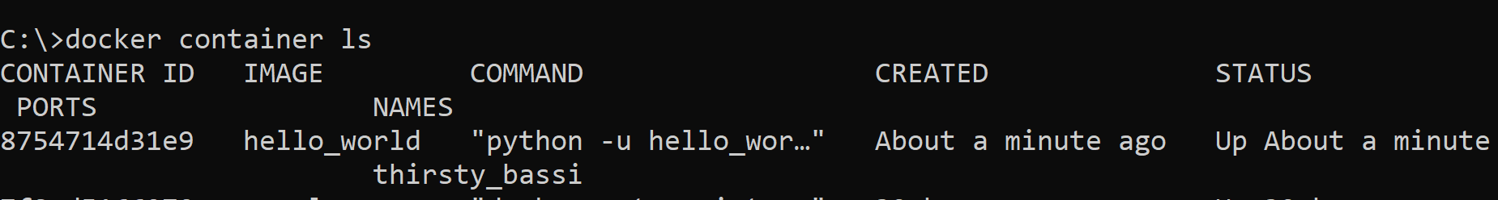
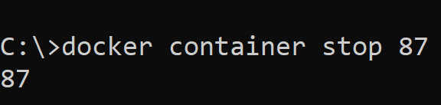
Breaking the endless loop
Open a second command prompt to know the id of the endlessly running container: docker container ls
Stop that container: docker container stop 87 (and then verify that the loop in the first command prompt has ended after this)

Slide 39
‘Hello World’ in Python Flask

Slide 40
hello_flask.py (C:\lectures\CDAC\Cloud\docker\hello-world-python-flask)
from flask import Flask
helloflask = Flask(__name__)
@helloflask.route("/")
def run():
return "{\"message\":\"Hello Flask!\"}"
if __name__ == "__main__":
helloflask.run(host="0.0.0.0", port=int("5000"), debug=True)

Slide 41
Dockerfile
FROM python:alpine3.10
WORKDIR /app
COPY . /app
RUN pip install -r requirements.txt
EXPOSE 5000
CMD python ./hello_flask.py
#COPY requirements.txt /app/requirements.txt
#ENTRYPOINT ["python", "./hello_flask.py"]

Slide 42
requirements.txt
flask

Slide 43
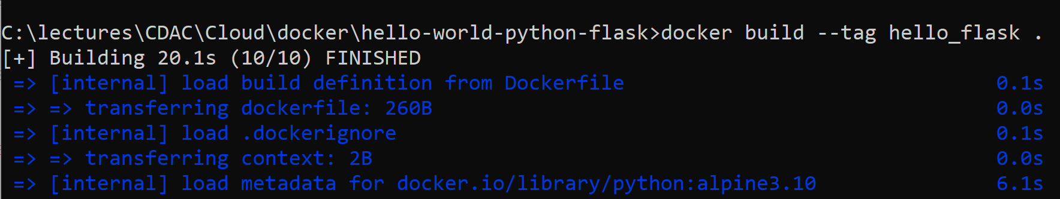
Build image
docker build -t hello_flask .

Slide 44
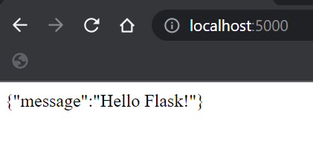
Execute
docker run -d -p 5000:5000 hello_flask

Slide 45
Tomcat-based Application on Docker

Slide 46
Create the following folder structure
C:\lectures\CDAC\Cloud\docker\mytomcatdockerapp\webapp\WEB-INF\classes
C:\lectures\CDAC\Cloud\docker\mytomcatdockerapp\webapp\WEB-INF\lib

Slide 47
Create web.xml in C:\lectures\CDAC\Cloud\docker\mytomcatdockerapp\webapp\WEB-INF
<?xml version="1.0"?>
<web-app>
</web-app>

Slide 48
Create hello.html in C:\lectures\CDAC\Cloud\docker\mytomcatdockerapp\webapp
<html>
<head>
<title>Hello World</title>
</head>
<body>
<h3>Hello World!</h3>
</body>
</html>

Slide 49
Create index.jsp in C:\lectures\CDAC\Cloud\docker\mytomcatdockerapp\webapp
<!doctype html>
<h1> It works! </h1>
<%
for (int i = 0; i < 2; ++i) {
out.println("<p> Hello, world Docker! (: </p>");
}
%>

Slide 50
Create Dockerfile in C:\lectures\CDAC\Cloud\docker\mytomcatdockerapp
FROM tomcat:8.0-alpine
ADD mytomcatdockerapp.war /usr/local/tomcat/webapps/mytomcatdockerapp.war
EXPOSE 8080
CMD ["/usr/local/tomcat/bin/catalina.sh", "run"]

Slide 51
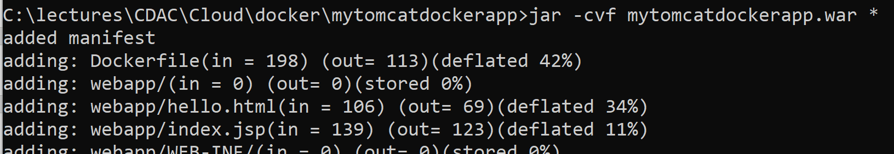
Create a WAR file
jar -cvf mytomcatdockerapp.war *

Slide 52
Build and Run Docker image
docker build -t mytomcatdocker .
docker run -it -d --name=mytomcatdocker -p 8888:8080 mytomcatdocker
(-i or -interactive: Keep STDIN open even if not attached, -t, --tty: Allocate a pseudo-TTY)

Slide 53
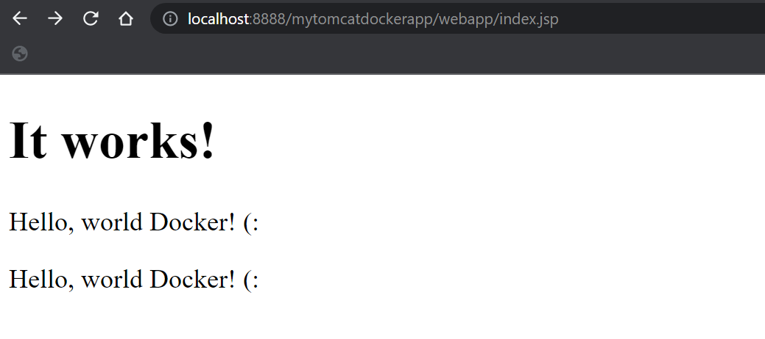
Test (See next slide also)
http://localhost:8888/mytomcatdockerapp/webapp/index.jsp

Slide 54
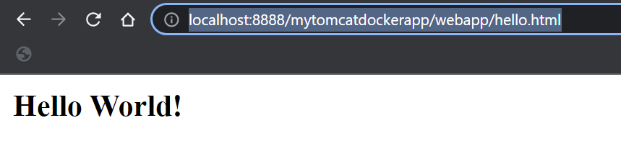
Test (See next slide also)
http://localhost:8888/mytomcatdockerapp/webapp/hello.html

Slide 55
We can try and debug, all seems to be ok!
Inspect the container
On the command prompt:
docker exec -it mytomcatdocker sh
cd webapps
ls –l

Slide 56
Inside a Container

Slide 57
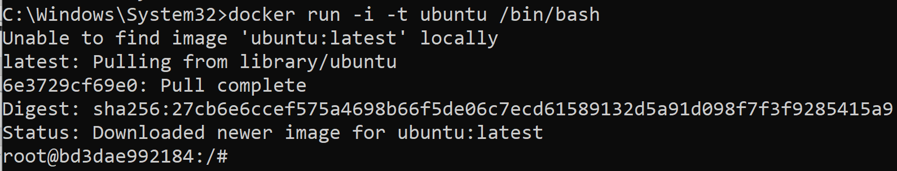
Let us Pull and Run Ubuntu with –it Option
docker run -i -t ubuntu /bin/bash
It will get the latest Ubuntu image and open the interactive terminal (shell)

Slide 58
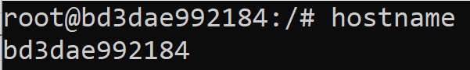
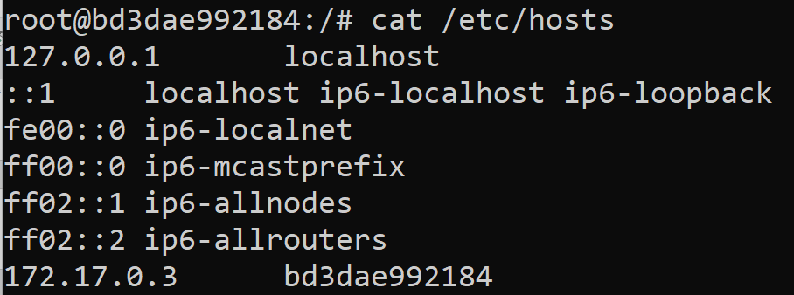
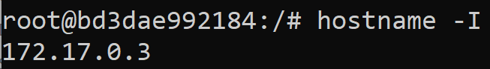
Working Inside the Container
hostname
cat /etc/hosts
hostname -I
Docker has added a host entry for our container with its IP address
Just reconfirming our IP address

Slide 59
Java Application with User Input

Slide 60
Create PrimeNumber.java (C:\lectures\CDAC\Cloud\docker\javainputdocker)
import java.util.Scanner;
public class PrimeNumber {
public static void main(String[] args) {
Scanner sc = new Scanner(System.in);
System.out.println("Prime number check ... Please enter a number: ");
int num = sc.nextInt();
boolean isPrime = true;
for(int i = 2; i < num/2; i++) {
if(num % i == 0) {
isPrime = false;
break;
}
}
if(isPrime)
System.out.println(num + " is a prime number");
else
System.out.println(num + " is not a prime number");
sc.close();
}
}

Slide 61
Dockerfile (C:\lectures\CDAC\Cloud\docker\javainputdocker)
FROM openjdk:12-alpine
COPY . /usr/src/myjavaapp
WORKDIR /usr/src/myjavaapp
RUN javac PrimeNumber.java
CMD ["java", "PrimeNumber"]

Slide 62
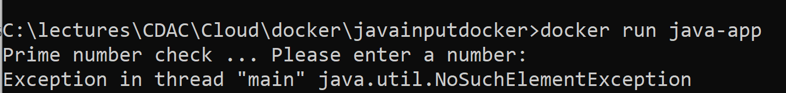
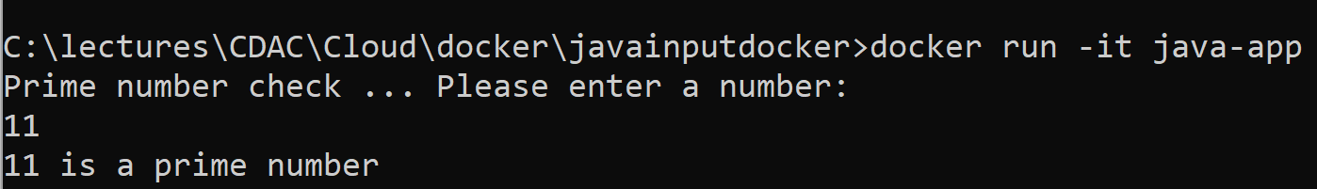
Build image and run
docker build -t java-app .
docker run java-app
To resolve: docker run –it java-app

Slide 63
Using Ready Images

Slide 64
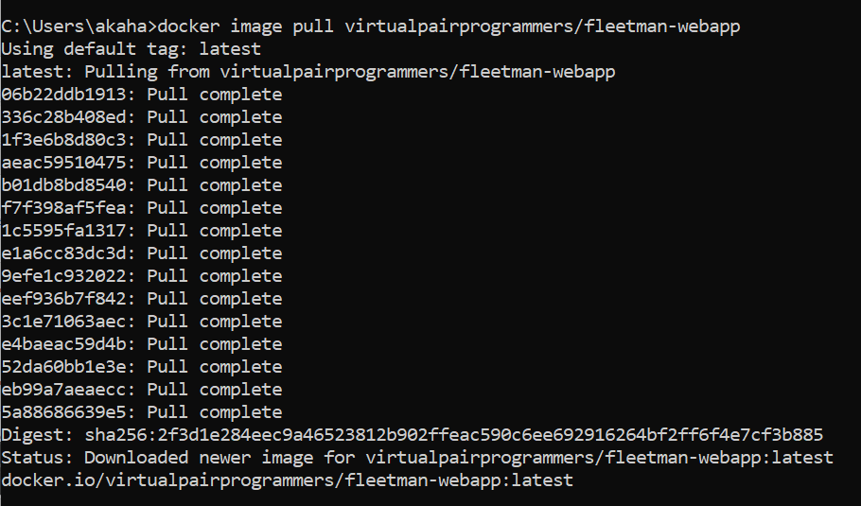
Downloading Images
docker image pull <image name> - Download an image from DockerHub
docker image pull virtualpairprogrammers/fleetman-webapp

Slide 65
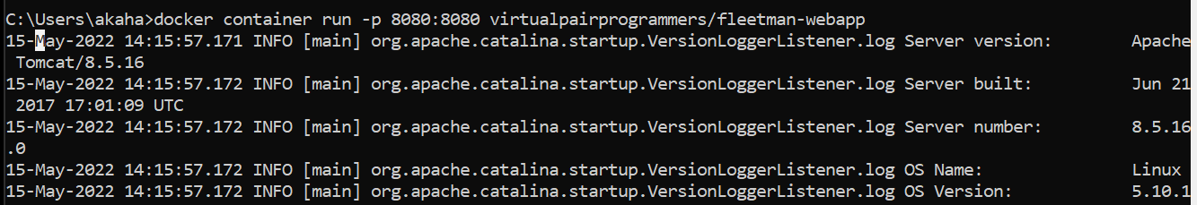
Running Containers (Image->Container)
docker container run -p <public port>:<container port> <image name> - Run and publish the container on a specific port
docker container run –p 8080:8080 virtualpairprogrammers/fleetman-webapp

Slide 66
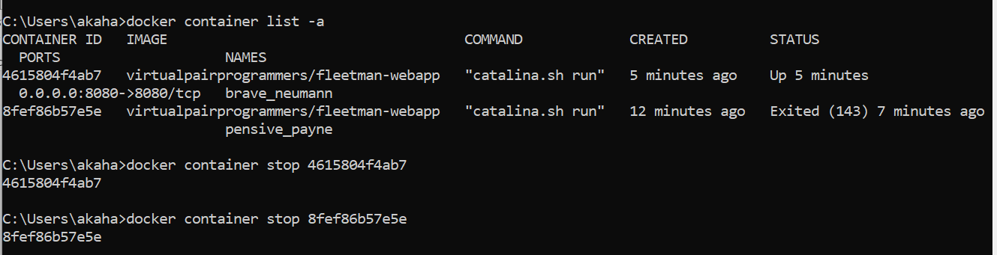
Stopping Containers
Ctrl+C does not work in most cases – Since it is running as a Linux process (remember, Docker Desktop is actually a Linux VM)
So, open a separate command prompt, check the container id(s) and stop them

Slide 67
Listing and Stopping Containers – Commands
More commands: https://docs.docker.com/engine/reference/builder/
docker container list –a
List all containers, even the stopped ones
docker container stop <container id>
Stop a running container
docker container start <container id>
Restart a stopped container
docker container rm <container id>
Remove a stopped container
docker container prune
Remove all stopped containers

Slide 68
Docker Hub
Repository of ready-made Docker images
Created by people/companies for public usage
Suppose we want an Ubuntu image to start with (as we want to create an Ubuntu-based container)
Go to hub.docker.com and search for ubuntu (See next slides)

Slide 69
Our Requirement
Our app
We will create
Java
Required
Ubuntu
Required
Our laptop’s Windows Operating System

Slide 70
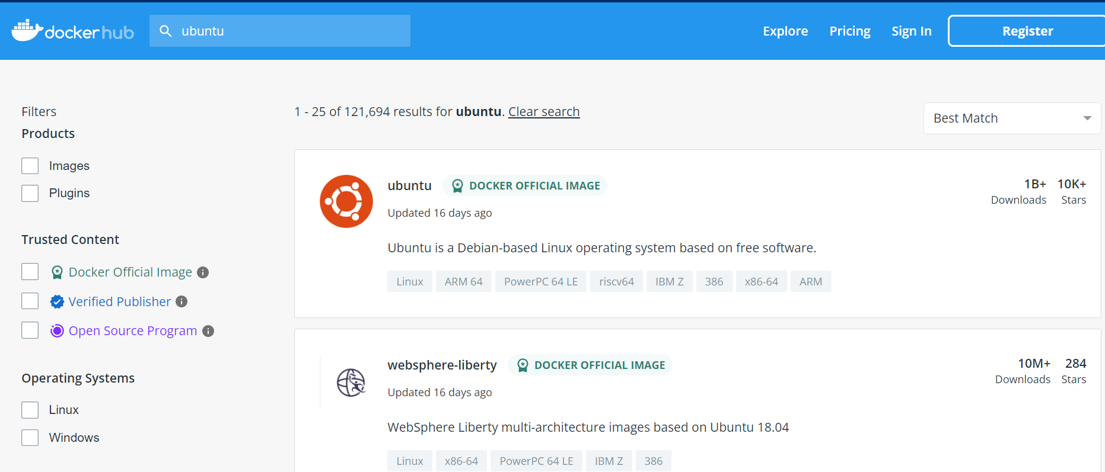
Finding Base Images

Slide 71
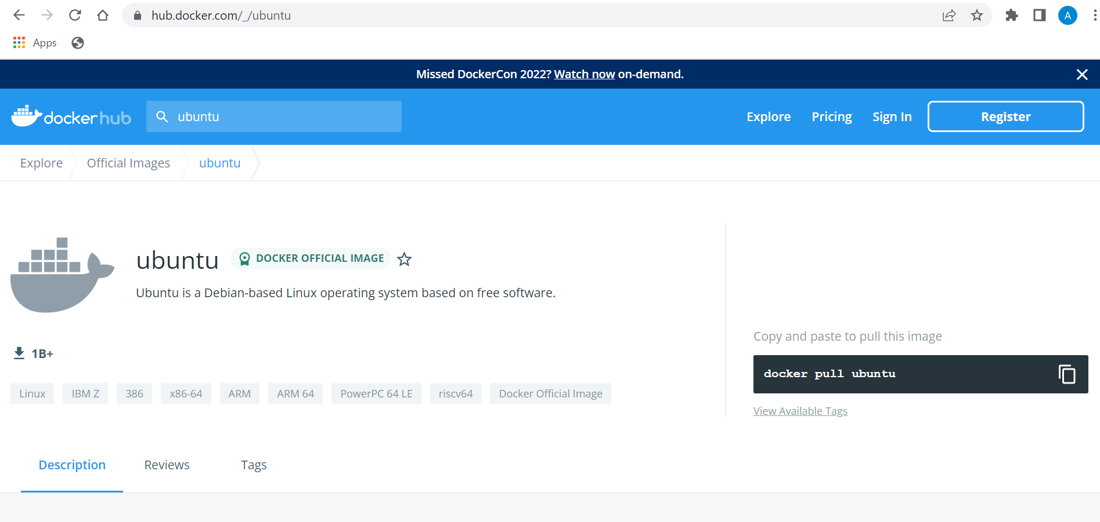
Downloading Base Images

Slide 72
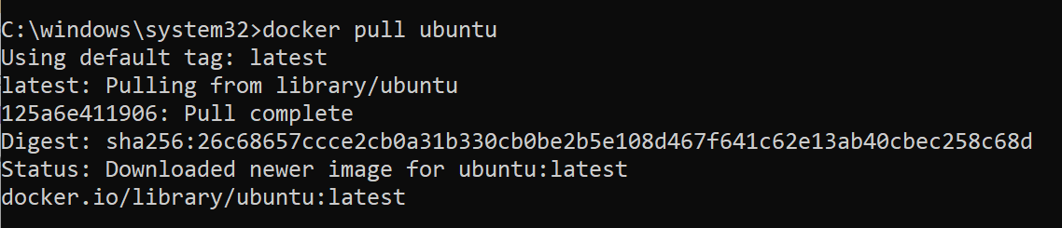
Downloading Base Images - Demo
docker pull ubuntu

Slide 73
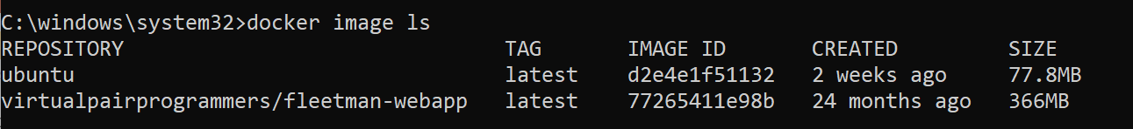
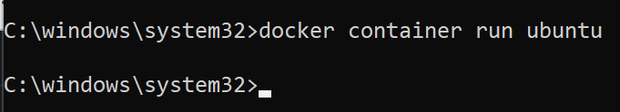
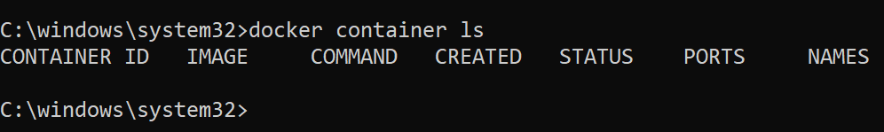
Trying to run the Base Image as a Container
docker image ls
docker container run ubuntu (Note: No port numbers are required, since it is a server) – Nothing happens!
docker container ls -> To confirm

Slide 74
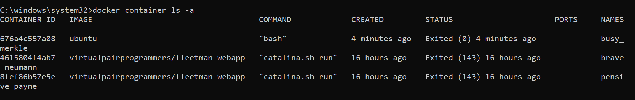
Why does the Base Image not Run?
docker container ls –a
The ubuntu container exists! Then why is it not running?
It is running a command bash, which expects a script and there is none. It does not start a terminal on its own.

Slide 75
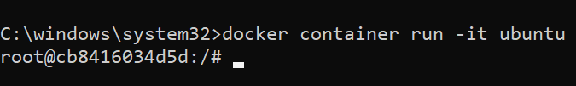
Running the Base Image
docker container run -it ubuntu
-i means interactive and –t means terminal
We can combine into a single parameter –it
Now it has started an Ubuntu terminal

Slide 76
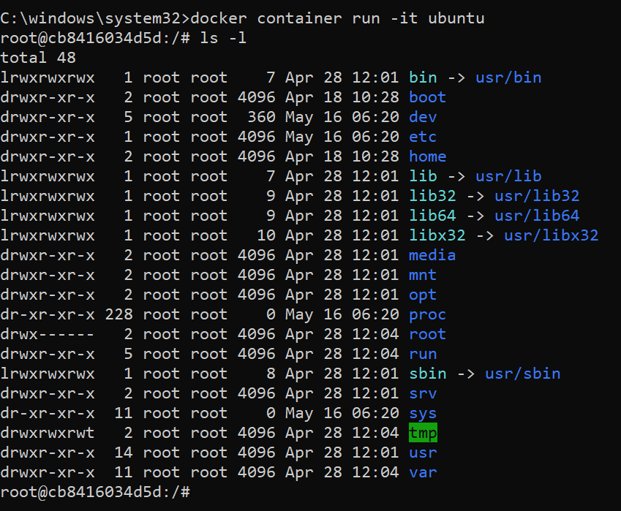
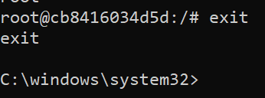
Running the Base Image

Slide 77
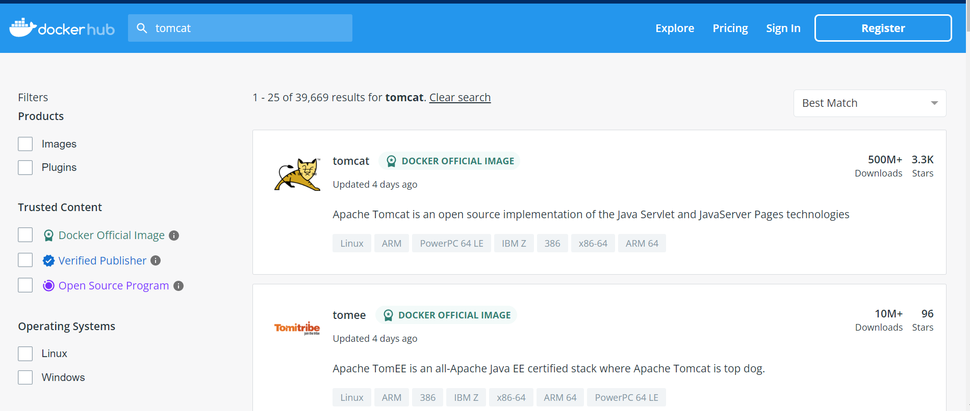
Running a Tomcat Container
Search for Tomcat on Docker Hub

Slide 78
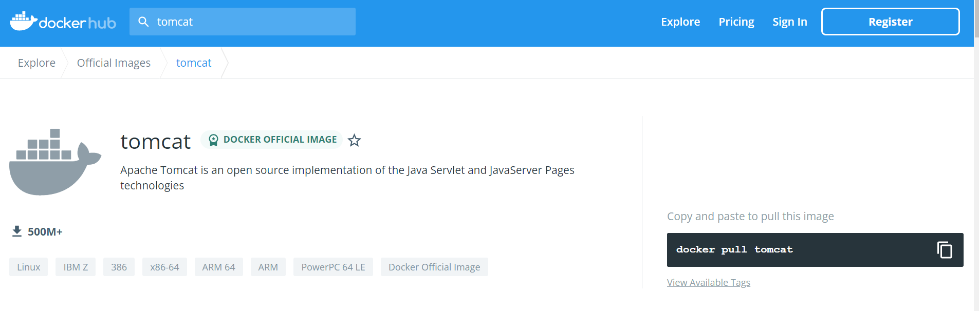
Downloading the Tomcat Image

Slide 79
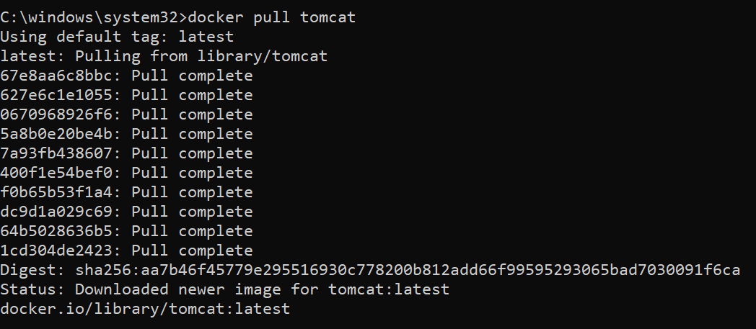
Downloading Tomcat Image
docker pull tomcat

Slide 80
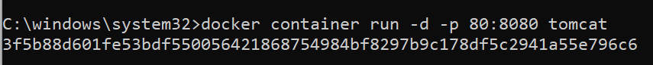
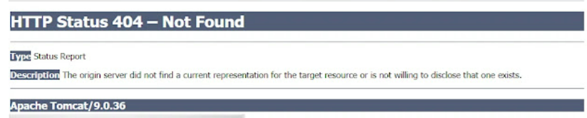
Run the Tomcat Container and Test
docker container run –d –p 80:8080 tomcat
Note: d means run in detached (background) mode
If you get a 404 error, see next slide

Slide 81
Solving the Tomcat 404 Error – 1
docker container stop 3f
docker container rm 3f
docker container prune -> Delete all the stopped containers
docker container run -d --name mytomcat -p 8080:8080 tomcat (Either port 80 or 8080 for external port is fine)

Slide 82
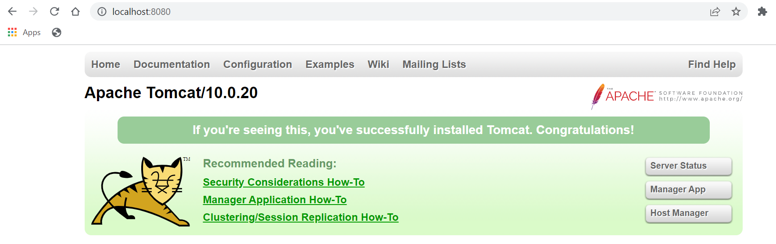
Solving the Tomcat 404 Error – 2
docker exec -it mytomcat /bin/bash
root@3ac9336e730d:/usr/local/tomcat# mv webapps webapps2
root@3ac9336e730d:/usr/local/tomcat# mv webapps.dist/ webapps
root@3ac9336e730d:/usr/local/tomcat# exit
exit

Slide 83
What was the Problem?
The webapps folder is moved to the webapps.dist folder.
So, the webapps folder is empty and there are no files to serve on the browser.
That is when you saw the error message The origin server did not find a current representation for the target resource or is not willing to disclose that one exists.
To re-enable the webapps, we need to move the files from webapps.dist to webapps.

Slide 84
Using Existing Images

Slide 85
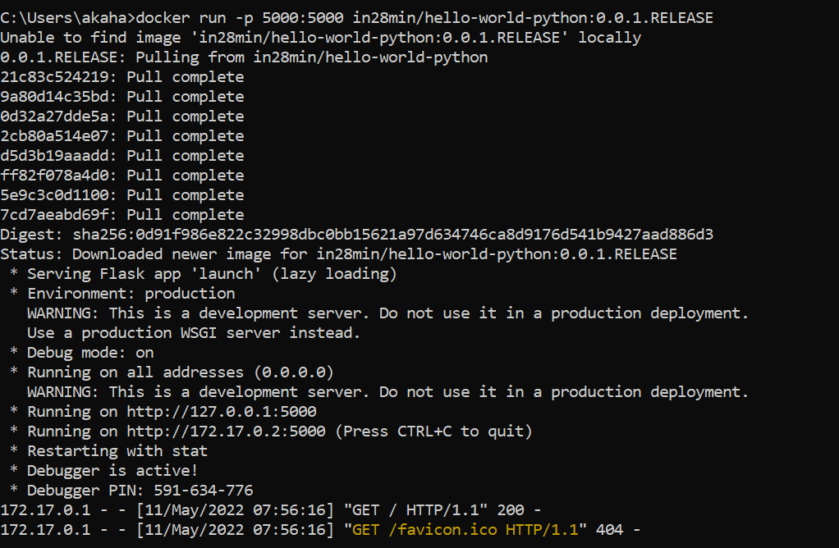
Basic Test
docker run -p 5000:5000 in28min/hello-world-python:0.0.1.RELEASE

Slide 86

Test

Slide 87

Basic Test Output

Slide 88

Verify that the Container is Running in Docker

Slide 89
Traditional Deployment
Applications
Tomcat, MySQL Server, Java, Python, …
Software
Operating System
Hardware

Slide 90

How did we get the Output?

Slide 91

How did we get the Output?

Slide 92

How did we get the Output?

Slide 93
How did we get the Output?
The container contains all the software and dependencies that are needed to run the ‘Hello World’ program.
Once we obtain the container image from the DockerHub URL and execute it using Docker, we see the output in the browser.
Docker will first search for the container image hello-world-python:0.0.1.RELEASE locally, and if it cannot find it, it will go to DockerHub.
When an image is running, it is called as a container.
5000:5000 specifies the host port and the container port, respectively
-p means publish

Slide 94
Docker Terminology
hello-world-python is called as Docker repository
0.0.1.RELEASE is called as tag
hello-world-python:0.0.1.RELEASE is called as image
When the image is running, it is called as container
(See next slide)

Slide 95

Image and Container

Slide 96

Running Two Containers at the Same Time
With the first command prompt running the first container, try the following – fails
Reason: Port number 5000 is already in use. Try another port (next slide).

Slide 97


Running Two Containers at the Same Time

Slide 98
Launching a Container in Detached Mode
Close all command prompts and browsers and start a new command prompt.
docker run -d -p 5000:5000 in28min/hello-world-python:0.0.1.RELEASE

Slide 99

Testing Detached Mode

Slide 100

What is Happening?
The container is running in the background
We can check the container based on its id
docker logs <container-id>

Slide 101

Short form for the container id
We can specify just the first four letters of the container id
docker logs <container-id’s first four letters>

Slide 102

Finding Out Which Images Do We Have
docker images

Slide 103


Finding Out Which Containers are/have been Running
docker container ls
docker container ls -a

Slide 104

Stopping a Container
docker container stop <container id>

Slide 105

Docker Architecture

Slide 106

Docker Search Command
docker search mysql (ok are the official ones)

Slide 107
Import Docker Projects into Visual Studio Code
Code is on https://github.com/in28minutes/devops-master-class
Click on Code
Click on Download Zip (See next slide)

Slide 108

Import Docker Projects into Visual Studio Code

Slide 109

Open Folder in Visual Studio Code

Slide 110
Understanding How to Build a Docker Image – Python Application
Open projects -> hello-world -> hello-world-python
launch.py contains the code for the python application
from flask import Flask
helloworld = Flask(__name__)
@helloworld.route("/")
def run():
return "{\"message\":\"Hello World Python v1\"}"
if __name__ == "__main__":
helloworld.run(host="0.0.0.0", port=int("5000"), debug=True)

Slide 111
Understanding How to Build a Docker Image – Python Application
requirements.txt contains the dependency (in this case, the flask framework)
flask

Slide 112
Understanding How to Build a Docker Image – Python Application
Dockerfile contains instructions to create a docker image
FROM python:alpine3.10
WORKDIR /app
COPY . /app
RUN pip install -r requirements.txt
EXPOSE 5000
CMD python ./launch.py
#COPY requirements.txt /app/requirements.txt
#ENTRYPOINT ["python", "./launch.py"]

Slide 113
Understanding the Docker File
FROM python:alpine3.10
We want to use the ready-made Python docker image that is available to everyone and it should be packaged with the bare-minimum Linux variant called as alpine version 3.10
This is called as base image
WORKDIR /app
The working directory for our application
COPY . /app
Since our Python code is present in our current directory, copy it to the app folder

Slide 114
Understanding the Docker File
RUN pip install -r requirements.txt
For our Python application to work, we require the Flask framework. We have specified it in requirements.txt file. Using pip, we will install it. The RUN command executes the pip command.
EXPOSE 5000
We want to expose port 5000 to the external world.
CMD python ./launch.py
Start the command prompt and using the Python interpreter, execute the launch.py file.

Slide 115
Creating the Docker Image
First make a small change to launch.py file to indicate a new release:
def run():
return "{\"message\":\"Hello World Python v2\"}"
Then run this command:
C:\lectures\CDAC\Cloud\devops-master-class-master\projects\hello-world\hello-world-python>docker build -t in28min/hello-world-python:0.0.2.RELEASE .
See next slide

Slide 116


Creating the Docker Image

Slide 117

Running Our Image as a Container
C:\lectures\CDAC\Cloud\devops-master-class-master\projects\hello-world\hello-world-python>docker run -p 5000:5000 -d in28min/hello-world-python:0.0.2.RELEASE

Slide 118

Checking if it is Running
C:\lectures\CDAC\Cloud\devops-master-class-master\projects\hello-world\hello-world-python>docker container ls

Slide 119

Checking if it is Running
C:\lectures\CDAC\Cloud\devops-master-class-master\projects\hello-world\hello-world-python>docker logs -f f6cc2d3ad40efbc52de789d1e199bb519f430ab6633b37e8853d27dd8093836b

Slide 120

Browser Test

Slide 121

Pushing Image to Docker Repository
We will need to build the repository with our login id, because earlier we had built it with the id in28min
C:\lectures\CDAC\Cloud\devops-master-class-master\projects\hello-world\hello-world-python>docker build -t newdelthis/hello-world-python:0.0.2.RELEASE .

Slide 122
Pushing a Local Image to Docker Hub

Slide 123

Login to Docker Repository
docker login

Slide 124
Check our Local Image Id
docker image list
Copy this image id

Slide 125
Tag and Push the Image
docker tag a799de275731 newdelthis/tomcat-centos:latest
docker push newdelthis/tomcat-centos:latest
Local image id
Name to be given on Docker Hub

Slide 126

Verify on the Docker Hub Site

Slide 127
Using Docker to Build a Node/JavaScript Application (C:\lectures\CDAC\Cloud\devops-master-class-master\projects\hello-world\hello-world-nodejs)
index.js (Main code)
var express = require('express')
const process = require('process');
var expressapp = express()
expressapp.get('/', function (req, res) {
res.send('{"message":"Hello World JavaScript v1"}')
})
expressapp.listen(5000, function () {
console.log('Ready on port 5000!')
})
/* To Handle Ctrl C*/
process.on('SIGINT', function () {
process.exit();
});

Slide 128
Using Docker to Build a Node/JavaScript Application
package.json (Required for Node applications)
{
"name": "nodejs-hello-world",
"version": "1.0.0",
"description": "nodejs-hello-world",
"main": "index.js",
"scripts": {
"test": "echo \"Error: no test specified\" && exit 1"
},
"author": "cdac",
"dependencies": {
"express": "^4.17.1"
},
"devDependencies": {
"webpack": "^4.41.5"
},
"license": "MIT",
"repository": {}
}

Slide 129
Using Docker to Build a Node/JavaScript Application
Dockerfile
FROM node:8.16.1-alpine
WORKDIR /app
COPY . /app
RUN npm install
EXPOSE 5000
CMD node index.js
#ENTRYPOINT ["node", "index.js"]
#COPY package.json /app

Slide 130

Create the Docker Image
C:\lectures\CDAC\Cloud\devops-master-class-master\projects\hello-world\hello-world-nodejs>docker build -t newdelthis/hello-world-nodejs:0.0.2.RELEASE .

Slide 131

Check What is Running Currently
C:\lectures\CDAC\Cloud\devops-master-class-master\projects\hello-world\hello-world-nodejs>docker container ls

Slide 132

Stop the Python Container
C:\lectures\CDAC\Cloud\devops-master-class-master\projects\hello-world\hello-world-nodejs>docker container stop f6c

Slide 133

Start the Node.js Container
C:\lectures\CDAC\Cloud\devops-master-class-master\projects\hello-world\hello-world-nodejs>docker container run -d -p 5000:5000 newdelthis/hello-world-nodejs:0.0.2.RELEASE

Slide 134

Check that the Node.js Container is Running
C:\lectures\CDAC\Cloud\devops-master-class-master\projects\hello-world\hello-world-nodejs>docker logs -f cab8cf9cd18fd2d69c6343d593571a3e21603589a39c9b90516826d5b043c840

Slide 135

Test in Browser

Slide 136
Using Docker to Build a Java Application Container (C:\lectures\CDAC\Cloud\devops-master-class-master\projects\hello-world\hello-world-java\src\main\java\com\in28minutes\rest\webservices\restfulwebservices)
HelloWorldController.java
package com.in28minutes.rest.webservices.restfulwebservices;
import org.springframework.web.bind.annotation.GetMapping;
import org.springframework.web.bind.annotation.RestController;
@RestController
public class HelloWorldController {
@GetMapping(path = "/")
public String helloWorld() {
return "{\"message\":\"Hello World Java v1\"}";
}
}

Slide 137
Using Docker to Build a Java Application Container
RestfulWebServicesApplication.java
package com.in28minutes.rest.webservices.restfulwebservices;
import org.springframework.boot.SpringApplication;
import org.springframework.boot.autoconfigure.SpringBootApplication;
@SpringBootApplication
public class RestfulWebServicesApplication {
public static void main(String[] args) {
SpringApplication.run(RestfulWebServicesApplication.class, args);
}
}

Slide 138
Using Docker to Build a Java Application Container
application.properties
logging.level.org.springframework = debug
server.port = 5000

Slide 139
Using Docker to Build a Java Application Container
pom.xml for Dependencies
<?xml version="1.0" encoding="UTF-8"?>
<project xmlns="http://maven.apache.org/POM/4.0.0"
xmlns:xsi="http://www.w3.org/2001/XMLSchema-instance"
xsi:schemaLocation="http://maven.apache.org/POM/4.0.0 http://maven.apache.org/xsd/maven-4.0.0.xsd">
<modelVersion>4.0.0</modelVersion>
<groupId>com.in28minutes.rest.webservices</groupId>
<artifactId>hello-world-java</artifactId>
<version>0.0.1-SNAPSHOT</version>
<packaging>jar</packaging>
<description>Demo project for Spring Boot</description>
<name>hello-world-java</name>
<parent>
<groupId>org.springframework.boot</groupId>
<artifactId>spring-boot-starter-parent</artifactId>
<version>2.1.7.RELEASE</version>
<relativePath /> <!-- lookup parent from repository -->
</parent>
<properties>
<project.build.sourceEncoding>UTF-8</project.build.sourceEncoding>
<project.reporting.outputEncoding>UTF-8</project.reporting.outputEncoding>
<java.version>1.8</java.version>
<maven-jar-plugin.version>3.1.1</maven-jar-plugin.version>
</properties>
<dependencies>
<dependency>
<groupId>org.springframework.boot</groupId>
<artifactId>spring-boot-starter-web</artifactId>
</dependency>
<dependency>
<groupId>org.springframework.boot</groupId>
<artifactId>spring-boot-devtools</artifactId>
<scope>runtime</scope>
</dependency>
<dependency>
<groupId>org.springframework.boot</groupId>
<artifactId>spring-boot-starter-test</artifactId>
<scope>test</scope>
</dependency>
</dependencies>
<build>
<finalName>hello-world-java</finalName>
<plugins>
<plugin>
<groupId>org.springframework.boot</groupId>
<artifactId>spring-boot-maven-plugin</artifactId>
</plugin>
</plugins>
</build>
<repositories>
<repository>
<id>spring-snapshots</id>
<name>Spring Snapshots</name>
<url>https://repo.spring.io/snapshot</url>
<snapshots>
<enabled>true</enabled>
</snapshots>
</repository>
<repository>
<id>spring-milestones</id>
<name>Spring Milestones</name>
<url>https://repo.spring.io/milestone</url>
<snapshots>
<enabled>false</enabled>
</snapshots>
</repository>
</repositories>
<pluginRepositories>
<pluginRepository>
<id>spring-snapshots</id>
<name>Spring Snapshots</name>
<url>https://repo.spring.io/snapshot</url>
<snapshots>
<enabled>true</enabled>
</snapshots>
</pluginRepository>
<pluginRepository>
<id>spring-milestones</id>
<name>Spring Milestones</name>
<url>https://repo.spring.io/milestone</url>
<snapshots>
<enabled>false</enabled>
</snapshots>
</pluginRepository>
</pluginRepositories>
</project>

Slide 140
Using Docker to Build a Java Application Container
Dockerfile
# Build a JAR File
FROM maven:3.6.3-jdk-8-slim AS stage1
WORKDIR /home/app
COPY . /home/app/
RUN mvn -f /home/app/pom.xml clean package
# Create an Image
FROM openjdk:8-jdk-alpine
EXPOSE 5000
COPY --from=stage1 /home/app/target/hello-world-java.jar hello-world-java.jar
ENTRYPOINT ["sh", "-c", "java -jar /hello-world-java.jar"]

Slide 141
Exercise
Build the Java application image using Docker
Verify
Start
Test

Slide 142
Docker and Microservices
Example
Currency Exchange Service (CE)
USD 1 = 80 INR
EUR 1 = 82 INR
AUD 1 = 55 INR
Currency Conversion Service (CC)
USD 10 = 800 INR

Slide 143
Currency Exchange Service
Currency Conversion Service
Sample URL: http://localhost:8000/currency-exchange/from/EUR/to/INR
Sample json returned by the service:
{
"id": 10002,
"from": "EUR",
"to": "INR",
"conversionMultiple": 75.00,
"exchangeEnvironmentInfo": "37f1ad927c6e v1 27c6e"
}

Slide 144
Currency Conversion Service
Sample URL: http://localhost:8100/currency-conversion/from/EUR/to/INR/quantity/10
Sample json returned by the service:
{
"id": 10002,
"from": "EUR",
"to": "INR",
"conversionMultiple": 75.00,
"quantity": 10,
"totalCalculatedAmount": 750.00,
"exchangeEnvironmentInfo": "37f1ad927c6e v1 27c6e",
"conversionEnvironmentInfo": "fb6316b5713d v1 5713d"
}

Slide 145

Pull the Currency Exchange Microservice

Slide 146

Pull and Execute the Currency Exchange Microservice
C:\lectures\CDAC\Cloud\devops-master-class-master>docker run -p 8000:8000 --name=currency-exchange in28min/currency-exchange:0.0.1-RELEASE

Slide 147

Test it
http://localhost:8000/currency-exchange/from/EUR/to/INR

Slide 148

Pull and Execute the Currency Conversion Microservice in a second command prompt
C:\lectures\CDAC\Cloud\devops-master-class-master>docker run -p 8100:8100 --name=currency-conversion in28min/currency-conversion:0.0.1-RELEASE

Slide 149

Test it
http://localhost:8100/currency-conversion/from/USD/to/INR/quantity/10

Slide 150

But the Currency Exchange is Working Fine!

Slide 151

What is the Problem?
Default networking mode in Docker is the bridge network
Containers present in the bridge network cannot directly talk to each other
C:\Users\akaha>docker network list

Slide 152

Bridge network: More
C:\Users\akaha>docker network inspect bridge
Both the containers are running in the bridge network

Slide 153


Let us see which Containers are Running
C:\Users\akaha>docker container ls
Let us stop the unnecessary ones
docker stop practical_blackburn

Slide 154
Let us see which Containers are Running
Stop and remove the currency conversion container
C:\Users\akaha>docker stop currency-conversion
C:\Users\akaha>docker rm currency-conversion

Slide 155


Use Docker Link to Connect Microservices
Restart currency conversion service with a link to currency exchange
C:\Users\akaha>docker run -p 8100:8100 --env CURRENCY_EXCHANGE_SERVICE_HOST=http://currency-exchange --name=currency-conversion --link currency-exchange in28min/currency-conversion:0.0.1-RELEASE
C:\Users\akaha>docker rm 2d

Slide 156

Use Docker Link to Connect Microservices
C:\Users\akaha>docker run -p 8100:8100 --env CURRENCY_EXCHANGE_SERVICE_HOST=http://currency-exchange --name=currency-conversion --link currency-exchange in28min/currency-conversion:0.0.1-RELEASE

Slide 157


Retest
http://localhost:8000/currency-exchange/from/EUR/to/INR
http://localhost:8100/currency-conversion/from/EUR/to/INR/quantity/10

Slide 158
Better Option: Create a Custom Network for our Currency Services
C:\lectures\CDAC\Cloud\devops-master-class-master>docker container stop currency-exchange
C:\lectures\CDAC\Cloud\devops-master-class-master>docker container stop currency-conversion
C:\lectures\CDAC\Cloud\devops-master-class-master>docker rm currency-exchange
C:\lectures\CDAC\Cloud\devops-master-class-master>docker rm currency-conversion
C:\lectures\CDAC\Cloud\devops-master-class-master>docker network create currency-network

Slide 159

Restart Services
C:\lectures\CDAC\Cloud\devops-master-class-master>docker run -d -p 8000:8000 --name=currency-exchange --network=currency-network in28min/currency-exchange:0.0.1-RELEASE

Slide 160

Restart Services
docker run -d -p 8100:8100 --env CURRENCY_EXCHANGE_SERVICE_HOST=http://currency-exchange --name=currency-conversion --network=currency-network in28min/currency-conversion:0.0.1-RELEASE

Slide 161


Test
http://localhost:8000/currency-exchange/from/EUR/to/INR
http://localhost:8100/currency-conversion/from/EUR/to/INR/quantity/10

Slide 162
Docker Compose
Tool for defining and running multi-container Docker applications
Configuration information is stored in a YAML file
If we use Docker Desktop, Docker Compose is already installed with it

Slide 163
C:\lectures\CDAC\Cloud\devops-master-class-master\projects\microservices \docker-compose.yml
version: '3.7'
services:
currency-exchange:
image: in28min/currency-exchange:0.0.1-RELEASE
ports:
- "8000:8000"
restart: always
networks:
- currency-compose-network
currency-conversion:
image: in28min/currency-conversion:0.0.1-RELEASE
ports:
- "8100:8100"
restart: always
environment:
CURRENCY_EXCHANGE_SERVICE_HOST: http://currency-exchange
depends_on:
- currency-exchange
networks:
- currency-compose-network
# Networks to be created to facilitate communication between containers
networks:
currency-compose-network:

Slide 164
Understanding the YAML file
version: '3.7’ ---- Version of Docker Compose
services: ---- Lists all the microservices, databases, etc
currency-exchange: ---- Name of the currency exchange service
image: in28min/currency-exchange:0.0.1-RELEASE ---- Image for the service
ports:
- "8000:8000“ ---- Ports used for the service
restart: always ---- If the service goes down, bring it up automatically
networks: ---- It should be a part of the following networks
- currency-compose-network

Slide 165
Understanding the YAML file
currency-conversion:
….
environment:
CURRENCY_EXCHANGE_SERVICE_HOST: http://currency-exchange
depends_on: ---- Indicates that Docker should start currency exchange service first, as there is a dependency on it
- currency-exchange
networks:
- currency-compose-network
# Networks to be created to facilitate communication between containers
networks:
currency-compose-network:

Slide 166
Using Docker Compose to Launch the MicroServices
C:\lectures\CDAC\Cloud\devops-master-class-master\projects\microservices>docker container stop currency-exchange
C:\lectures\CDAC\Cloud\devops-master-class-master\projects\microservices>docker container stop currency-conversion
C:\lectures\CDAC\Cloud\devops-master-class-master\projects\microservices>docker-compose up
(If you get an ‘Error response from daemon: i/o timeout’ error, stop Docker Desktop and restart it in admin mode and then retry)

Slide 167

Docker Compose Output

Slide 168


Testing

Slide 169

Docker Compose in detached mode
Ctrl+C to stop the current Docker Compose
C:\lectures\CDAC\Cloud\devops-master-class-master\projects\microservices>docker-compose up -d

Slide 170

Verify
C:\lectures\CDAC\Cloud\devops-master-class-master\projects\microservices>docker container ls

Slide 171

Verify Network
C:\lectures\CDAC\Cloud\devops-master-class-master\projects\microservices>docker network ls
microservices_currency_... is created by Docker Compose (the word microservices comes from the directory name)

Slide 172

Inspect Network
C:\lectures\CDAC\Cloud\devops-master-class-master\projects\microservices>docker network inspect microservices_currency-compose-network

Slide 173


Stopping Docker Compose
C:\lectures\CDAC\Cloud\devops-master-class-master\projects\microservices>docker compose down
C:\lectures\CDAC\Cloud\devops-master-class-master\projects\microservices>docker system prune -a

Slide 174

A useful command
C:\lectures\CDAC\Cloud\devops-master-class-master\projects\microservices>docker compose config
Useful when we have an error in the YAML file

Slide 175
Python Flask and Docker

Slide 176
Create a New Application from Scratch
Create a directory flask-docker-app
C:\code>mkdir flask-docker-app
Go to the above directory
C:\code>cd flask-docker-app
Create a virtual environment
py -3 -m venv venv
Activate the virtual environment
venv\Scripts\activate
Install Flask
pip install Flask
We will create two files: app.py and Dockerfile

Slide 177
app.py (C:\code\flask-docker-app)
from flask import Flask
app = Flask(__name__)
@app.route('/')
def hello_world():
return '<h1>Hello World from Flask & Docker</h1>'
if __name__ == "__main__":
app.run(debug=True)

Slide 178
requirements.txt (C:\code\flask-docker-app)
flask

Slide 179


Test
python app.py

Slide 180
Dockerfile (C:\code\flask-docker-app)
# syntax=docker/dockerfile:1
FROM python:3.8-slim-buster
WORKDIR /python-docker
COPY requirements.txt requirements.txt
RUN pip3 install -r requirements.txt
COPY . .
CMD [ "python3", "-m" , "flask", "run", "--host=0.0.0.0"]

Slide 181
Understanding Dockerfile
# syntax=docker/dockerfile:1 → Tells the Docker builder what syntax should be used while parsing
FROM python:3.8-slim-buster → Use this base image
WORKDIR /python-docker → Tell Docker to use this directory for all its operations
COPY requirements.txt requirements.txt → Copy our requirements.txt file inside the image
RUN pip3 install -r requirements.txt → Install all dependencies mentioned in the above file
COPY . . → Copy the remaining files from our local directory into the Docker image directory
CMD [ "python3", "-m" , "flask", "run", "--host=0.0.0.0"] → Run our Flask application as a module and then make the container available externally to the browser

Slide 182

Build Docker Image
(venv) C:\code\flask-docker-app>docker build --tag python-docker .

Slide 183

Check and Run Docker Container
(venv) C:\code\flask-docker-app>docker images
(venv) C:\code\flask-docker-app>docker run -d -p 5000:5000 python-docker

Slide 184

Test

Slide 185
Python Flask and Docker Using Docker Compose (YAML)

Slide 186
First Stop the Previous Container
List all the running containers
(venv) C:\code\flask-docker-app>docker ps
Stop the container
(venv) C:\code\flask-docker-app>docker container stop 950825d9c8d7
Confirm
(venv) C:\code\flask-docker-app>docker ps -a

Slide 187
Create a New Application from Scratch
Create a directory flask-docker-app
C:\code>mkdir flask-docker-composer-app
Go to the above directory
C:\code>cd flask-docker-composer-app

Slide 188
main.py (c:\code\flask-docker-composer-app)
from flask import Flask
app = Flask(__name__)
@app.route('/')
def hello_world():
return 'Hello World'
if __name__ == '__main__':
app.run(host="0.0.0.0", debug=True)

Slide 189
docker-compose.yml
version: "3.8"
services:
app:
build: .
command: python main.py
ports:
- "5000:5000"
volumes:
- .:/python-flask

Slide 190
Dockerfile
FROM python:3.9.1
ADD . /python-flask
WORKDIR /python-flask
RUN pip install -r requirements.txt

Slide 191
requirements.txt
Flask

Slide 192

Compose and Run
C:\code\flask-docker-composer-app>docker compose up

Slide 193

Test

Slide 194
Docker Container for a Spring Boot Application

Slide 195

Spring Initializr

Slide 196

Directory Structure

Slide 197
Main Class (C:\code\spring\springbootdocker\src\main\java\com\example\springbootdocker\ SpringbootdockerApplication.java)
package com.example.springbootdocker;
import org.springframework.boot.SpringApplication;
import org.springframework.boot.autoconfigure.SpringBootApplication;
@SpringBootApplication
public class SpringbootdockerApplication {
public static void main(String[] args) {
SpringApplication.run(SpringbootdockerApplication.class, args);
}
}

Slide 198
Controller Class (C:\code\spring\springbootdocker\src\main\java\com\example\springbootdocker\ SpringbootdockerApplicationController.java)
package com.example.springbootdocker;
import org.springframework.web.bind.annotation.RestController;
import org.springframework.web.bind.annotation.RequestMapping;
@RestController
public class SpringbootdockerApplicationController {
@RequestMapping("/")
public String hello() {
return "Hello Spring Boot with Docker";
}
}

Slide 199

Test
C:\code\spring\springbootdocker>gradle bootRun

Slide 200

Now create a JAR file
C:\code\spring\springbootdocker>gradle build

Slide 201
Dockerfile (C:\code\spring\springbootdocker)
FROM openjdk:8-jdk-alpine
VOLUME /tmp
EXPOSE 8080
ARG JAR_FILE=build/libs/springbootdocker-0.0.1-SNAPSHOT.jar
ADD ${JAR_FILE} app.jar
ENTRYPOINT ["java","-Djava.security.egd=file:/dev/./urandom","-jar","/app.jar"]

Slide 202

Create Docker Image
C:\code\spring\springbootdocker>docker build -t springbootdockerexample .

Slide 203

Running the Application
If something is already running on port 5000, find it:
docker ps –a … Will list all docker containers
docker container stop <container id> … Will stop the container
docker run -p 5000:8080 springbootdockerexample

Slide 204
Docker Container for Spring Boot and MySQL
Ref: https://javatodev.com/docker-compose-for-spring-boot-with-mysql/

Slide 205
Download the code from Github
git clone https://github.com/javatodev/spring-boot-mysql-base-project.git (Downloaded as C:\lectures\CDAC\Cloud\docker\spring-boot-mysql-base-project)
Now create Dockerfile in the main application folder
FROM openjdk:8-jdk-alpine
LABEL maintainer="author@javatodev.com"
VOLUME /main-app
ADD build/libs/spring-boot-mysql-base-project-0.0.1-SNAPSHOT.jar app.jar
EXPOSE 8080
ENTRYPOINT ["java", "-jar","/app.jar"]

Slide 206
application.properties
spring.datasource.url=jdbc:mysql://mysql_db:3306/java_to_dev_app_db
spring.datasource.username=java_to_dev
spring.datasource.password=nE5kMc7JCGNqwDQM
spring.jpa.hibernate.ddl-auto=update
spring.datasource.initialization-mode=always

Slide 207
docker-compose.yml
version: "3.7"
services:
api_service:
build: .
restart: always
ports:
- 8080:8080
depends_on:
- mysql_db
command: sh -c './wait-for mysql_db:3306 -- npm start'
mysql_db:
image: "mysql:8.0"
restart: always
ports:
- 3307:3306
environment:
MYSQL_DATABASE: java_to_dev_app_db
MYSQL_USER: java_to_dev
MYSQL_PASSWORD: nE5kMc7JCGNqwDQM
MYSQL_ROOT_PASSWORD: nE5kMc7JCGNqwDQN

Slide 208

Build and Execute
gradle clean build
Will create a JAR file in the build/libs folder
docker-compose build
Build docker image
docker-compose up
Execute

Slide 209

Test

Slide 210
Using gradle with Java for Docker

Slide 211
HelloWorld.java (C:\lectures\CDAC\Cloud\docker\samples\intro\src\main\java\info\batey)
package info.batey;
public class HelloWorld {
public static void main(String[] args) {
System.out.println("Hello Docker, send me to production!");
}
}

Slide 212
Dockerfile (C:\lectures\CDAC\Cloud\docker\samples\intro)
FROM openjdk:11-jre-slim
# This automatically extracts the archive
ADD intro.tar /opt
ENTRYPOINT ["/opt/intro/bin/intro"]

Slide 213
build.gradle (C:\lectures\CDAC\Cloud\docker\samples\intro)
plugins {
id 'java'
id 'application'
id 'com.palantir.docker' version '0.25.0'
}
application {
mainClassName = 'info.batey.HelloWorld'
}
docker {
name 'intro:latest'
files tasks.distTar.outputs
}

Slide 214

Build the project
gradle compileJava

Slide 215

See the directory structure now

Slide 216

gradle distTar
Creates an intro.tar file for starting Java applications

Slide 217

Build Docker image using gradle
gradle docker

Slide 218

Verify and run
docker image list
docker run intro

Slide 219
Docker Compose

Slide 220

What is Docker Compose?
Docker Compose is a Docker tool used to define and run multi-container applications.
With Compose, you use a YAML file to configure your application’s services and create all the app’s services from that configuration.

Slide 221
How to Install and Use?
Install
Docker Compose is automatically installed with Docker Desktop
Use
Define your application environment using a Dockerfile. This way, it can be reproduced.
Define the services for your app in a docker-compose.yml file. This way, they can run in an isolated environment.
Run docker-compose to start your app.

Slide 222
docker-compose.yml file Structure
version: 'X'
services:
web:
build: .
ports:
- "5000:5000"
volumes:
- .:/code
redis:
image: redis

Slide 223
docker-compose.yml file Example
version: '3'
services:
web:
# Path to dockerfile.
# '.' represents the current directory in which
# docker-compose.yml is present.
build: .
# Mapping of container port to host
ports:
- "5000:5000"
# Mount volume
volumes:
- "/usercode/:/code"
# Link database container to app container
# for reachability.
links:
- "database:backenddb"
database:
# image to fetch from docker hub
image: mysql/mysql-server:5.7
# Environment variables for startup script
# container will use these variables
# to start the container with these define variables.
environment:
- "MYSQL_ROOT_PASSWORD=root"
- "MYSQL_USER=testuser"
- "MYSQL_PASSWORD=admin123"
- "MYSQL_DATABASE=backend"
# Mount init.sql file to automatically run
# and create tables for us.
# everything in docker-entrypoint-initdb.d folder
# is executed as soon as container is up nd running.
volumes:
- "/usercode/db/init.sql:/docker-entrypoint-initdb.d/init.sql"

Slide 224
docker-compose.yml file Explanation
version ‘3’: This denotes that we are using version 3 of Docker Compose, and Docker will provide the appropriate features. At the time of writing this article, version 3.7 is latest version of Compose.
services: This section defines all the different containers we will create. In our example, we have two services, web and database.
web: This is the name of our Flask app service. Docker Compose will create containers with the name we provide.
build: This specifies the location of our Dockerfile, and . represents the directory where the docker-compose.yml file is located.
ports: This is used to map the container’s ports to the host machine.

Slide 225
docker-compose.yml file Explanation
volumes: This is just like the -v option for mounting disks in Docker. In this example, we attach our code files directory to the containers’ ./code directory. This way, we won’t have to rebuild the images if changes are made.
links: This will link one service to another. For the bridge network, we must specify which container should be accessible to which container using links.
image: If we don’t have a Dockerfile and want to run a service using a pre-built image, we specify the image location using the image clause. Compose will fork a container from that image.
environment: The clause allows us to set up an environment variable in the container. This is the same as the -e argument in Docker when running a container.

Slide 226
Using Docker Compose
docker-compose build
This command builds images in the docker-compose.yml file.
The job of the build command is to get the images ready to create containers.
So if a service is using a prebuilt image, it will skip this service.
docker-compose images
This command will list the images you have built using the current docker-compose file.
docker-compose stop
This command stops the running containers of specified services.
docker-compose run
This is similar to the docker run command. It will create containers from images built for the services mentioned in the compose file.
docker-compose up
This command does the work of the docker-compose build and docker-compose run commands. It builds the images if they are not located locally and starts the containers. If images are already built, it will fork the container directly.
docker-compose ps
This command list all the containers in the current docker-compose file. They can then either be running or stopped.
docker-compose down
This command is similar to the docker system prune command. However, in Compose, it stops all the services and cleans up the containers, networks, and images.

Slide 227
Hands-on
Create directory: C:\lectures\CDAC\Cloud\docker\docker-compose-example
Create a few files in this directory as shown next

Slide 228
Hands-on – app.py
import time
import redis
from flask import Flask
app = Flask(__name__)
cache = redis.Redis(host='redis', port=6379)
def get_hit_count():
retries = 5
while True:
try:
return cache.incr('hits')
except redis.exceptions.ConnectionError as exc:
if retries == 0:
raise exc
retries -= 1
time.sleep(0.5)
@app.route('/')
def hello():
count = get_hit_count()
return 'Hello World! I have been seen {} times.\n'.format(count)

Slide 229
Hands-on – app.py
import time
import redis
from flask import Flask
app = Flask(__name__)
cache = redis.Redis(host='redis', port=6379)
def get_hit_count():
retries = 5
while True:
try:
return cache.incr('hits')
except redis.exceptions.ConnectionError as exc:
if retries == 0:
raise exc
retries -= 1
time.sleep(0.5)
@app.route('/')
def hello():
count = get_hit_count()
return 'Hello World! I have been seen {} times.\n'.format(count)

Slide 230
requirements.txt
flask
redis

Slide 231
Dockerfile
# syntax=docker/dockerfile:1
FROM python:3.7-alpine
WORKDIR /code
ENV FLASK_APP=app.py
ENV FLASK_RUN_HOST=0.0.0.0
RUN apk add --no-cache gcc musl-dev linux-headers
COPY requirements.txt requirements.txt
RUN pip install -r requirements.txt
EXPOSE 5000
COPY . .
CMD ["flask", "run"]

Slide 232
docker-compose.yml
version: "3.9"
services:
web:
build: .
ports:
- "8000:5000"
redis:
image: "redis:alpine"

Slide 233

Test
Open a command prompt and type docker-compose up
Open browser and type localhost:8080 or http://127.0.0.1:8000
To stop, docker compose down

